Slide 1

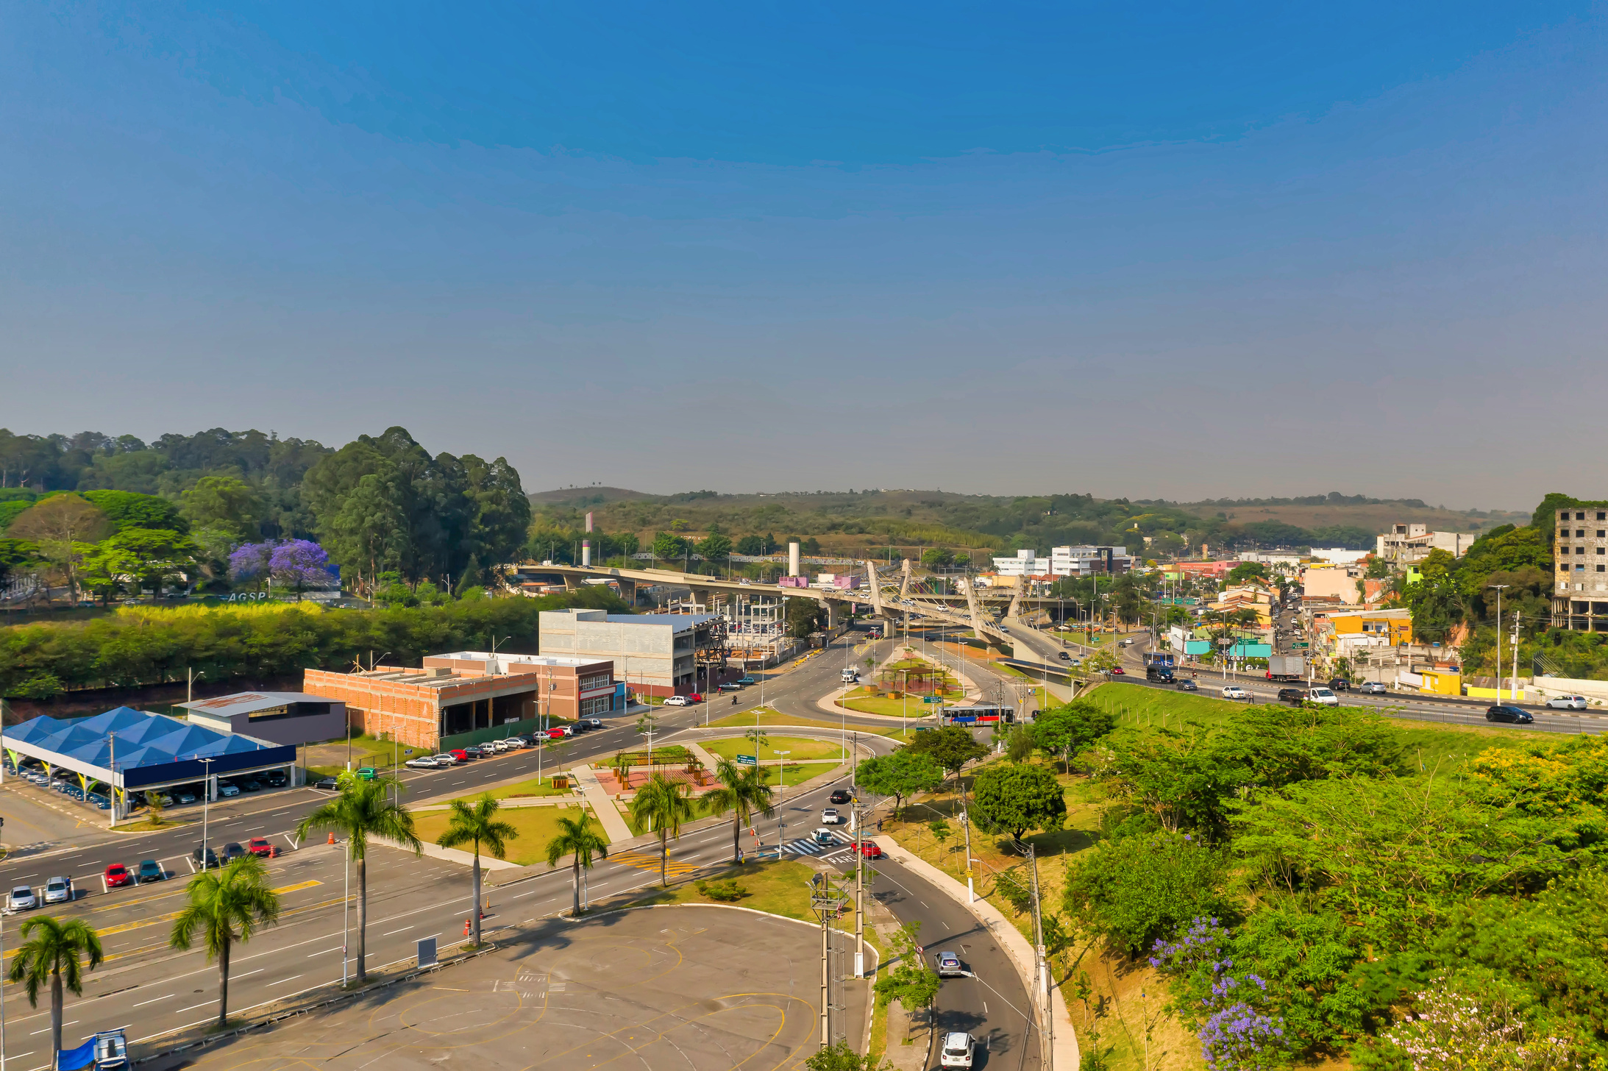
OUTLAND ADVENTURES CASE STUDY
Presented by:
Puna Poudel
Zachary Brown

Slide 2



CASE STUDY DESCRIPTION
Overview
Outland Adventures provides guided trips and equipment for outdoor enthusiasts.
Business Questions
Are enough customers buying equipment?
Are any locations experiencing a downward trend in bookings?
Is there equipment older than five years?

Slide 3
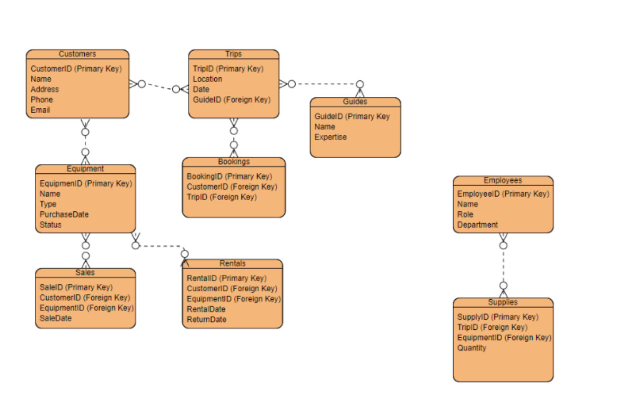
FINALIZED ERD
Key entities include Customers, Trips, Guides, Equipment, Sales, Rentals, Employees, Supplies, Bookings, and Locations.

Slide 4



DESCRIPTION OF REPORTS

Slide 5

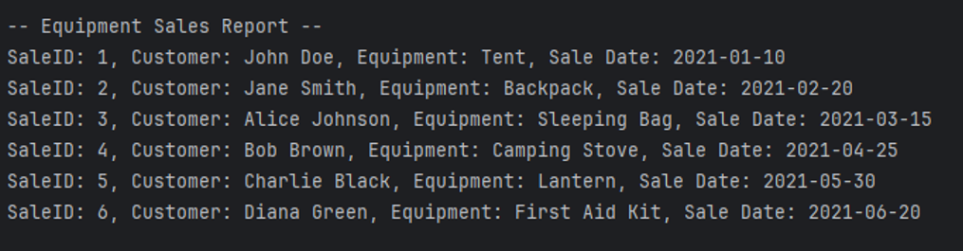
Equipment Sales Report
Purpose: Determine if enough equipment is being sold to justify keeping inventory.
Explanation: Shows sales data including customer names, equipment sold, and sale dates.

Slide 6
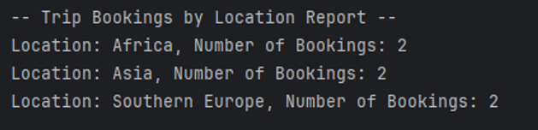
Trip Bookings by Location
Purpose: Identify booking trends by location.
Explanation: Shows the number of bookings per location to identify trends.

Slide 7
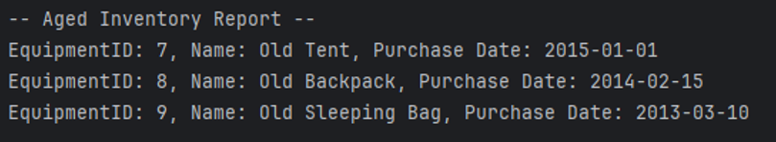
Aged Inventory Report
Purpose: Identify equipment older than five years for management and replacement.
Explanation: Lists equipment older than five years to help manage inventory.

Slide 8




ASSUMPTIONS
01
Assumed customers are both individuals and groups.
02
Assumed trips are organized by guides with specific expertise.
03
Assumed equipment is either rented or sold based on customer needs.

Slide 9


Thank You !

